Slide 1


http://www.comp.nus.edu.sg/~cs2100/
Welcome
(AY2018/9 Semester 2)

Slide 2
Welcome to CS2100
Lecturers
Course Materials
Course Description
Assessments
Textbooks
Admin Matters

Slide 3
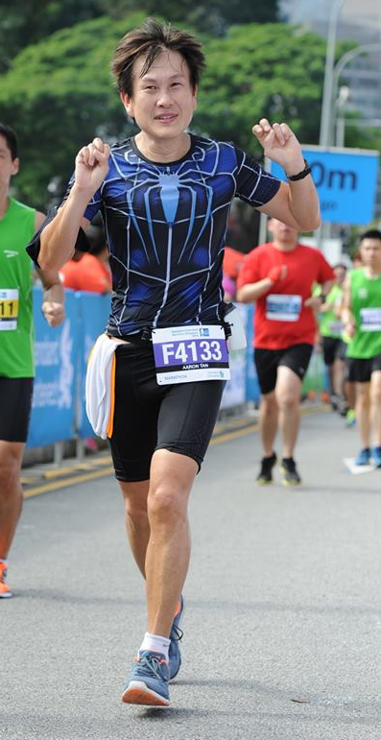
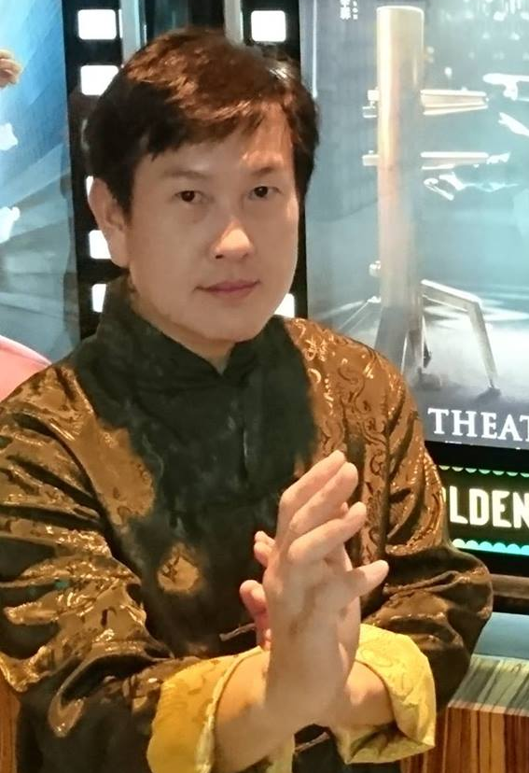
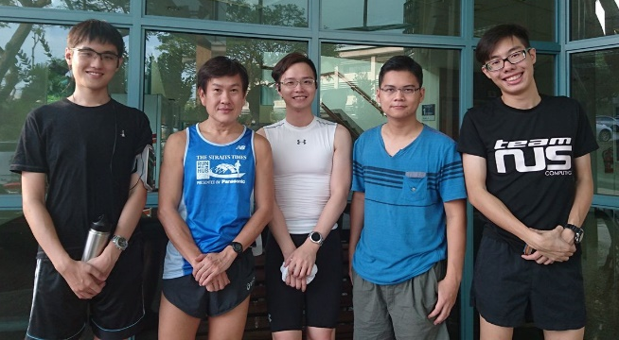
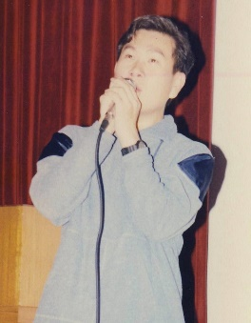
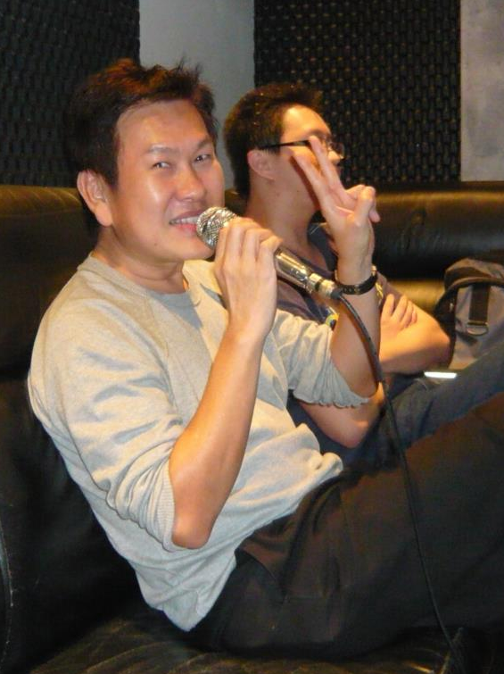
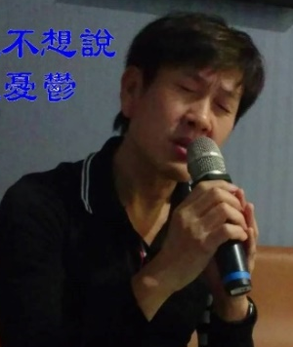
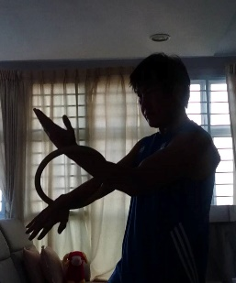
1. Lecturers
Running
Weekly group run with students. You’re welcome to join us!
Check out facebook.
Mr Tan Tuck Choy, Aaron
Office: COM1-03-12
Email: tantc@comp.nus.edu.sg
Singing
Admin appointment:
Assistant Dean (Undergraduate Studies)
Wing Chun
Karaokeing with students.

Slide 4
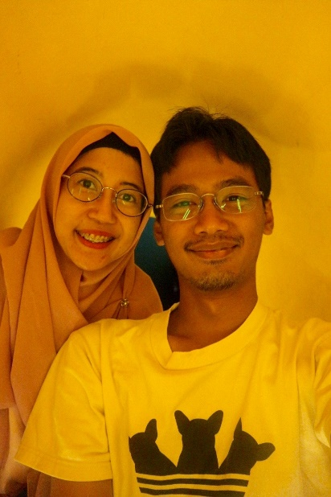
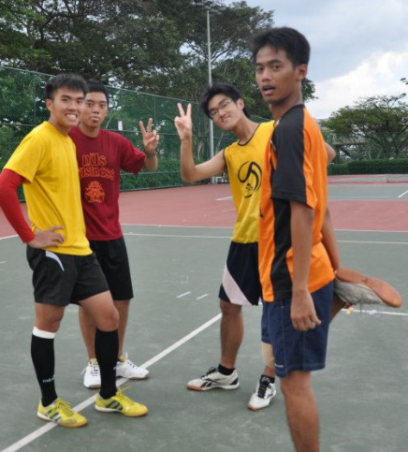
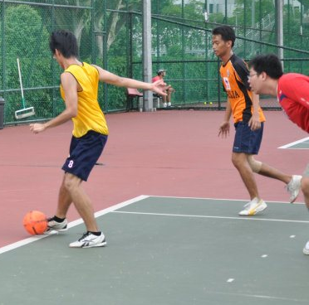
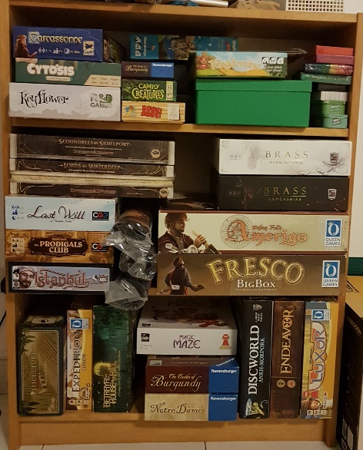
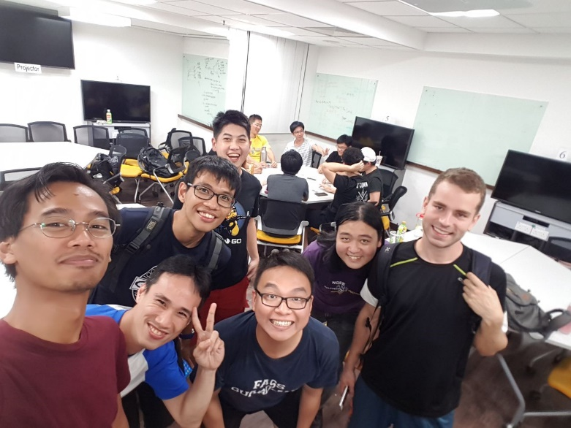
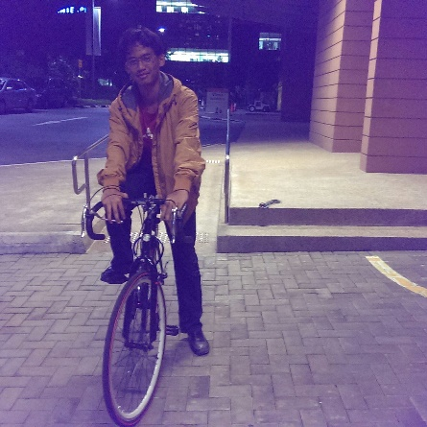
1. Lecturers
Soccer
Board Games
Adi Yoga Sidi Prabawa
Office: COM2-02-55
Email: dcsaysp@nus.edu.sg
Cycling
My shelfie showing partial collections
NUS Board Game Club (every Friday & Saturday @ YIH or E4-04-04)

Slide 5
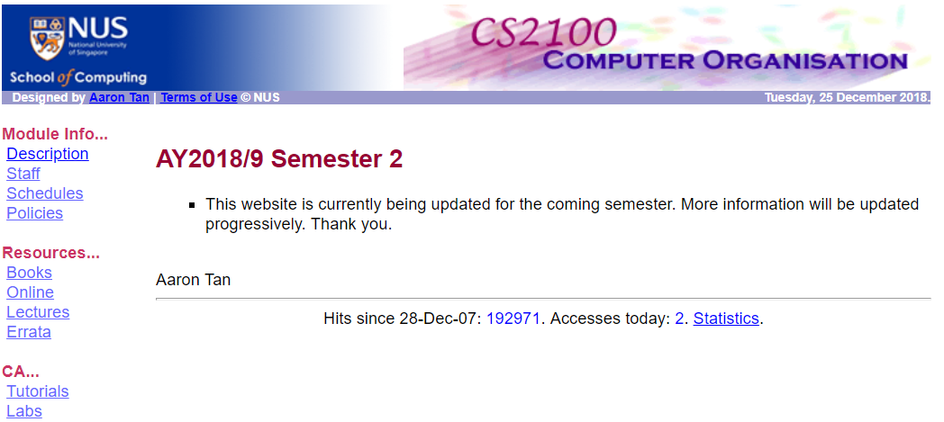
2. Course Materials
CS2100 website
https://www.comp.nus.edu.sg/~cs2100
LumiNUS
https://luminus.nus.edu.sg

Slide 6
3. Course Description (1/3)
The objective of this module is to familiarise students with the fundamentals of computing devices
The basics of data representation
How the various parts of a computer work, separately and with each other
Topics
C programming language
Data representation and number systems
Assembly language
Processor datapath and control
Pipelining
Cache
Combinational and sequential circuit design

Slide 7
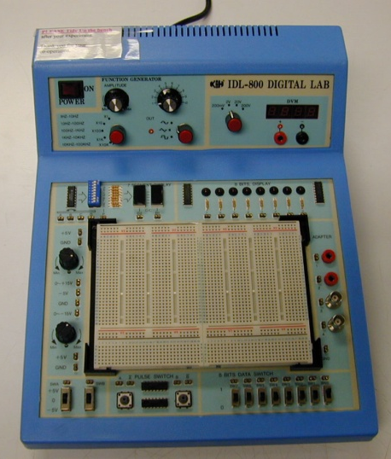
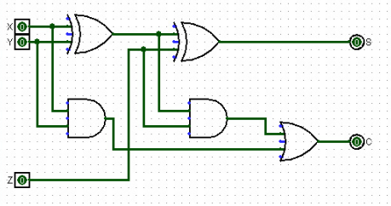
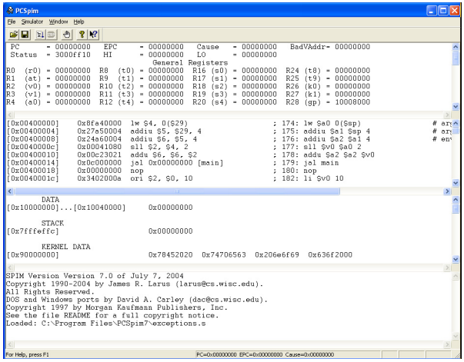
3. Course Description (2/3)
Practical aspects
Logic design experiments
Logisim software
QTSpim software

Slide 8
3. Course Description (3/3)
Quotes
“What I hear, I forget. What I see, I remember. What I do, I understand”
– Chinese Proverb 不闻不若闻之，闻之不若见之，见之不若知之，知之不若行之；学至于行之而止矣。 – 《荀子·儒效》
“The important thing is to understand what you are doing, rather than to get the right answer” – Tom Lehrer

Slide 9
4. Assessments
CA component | Weightage
Tutorial attendance | 5%
Assignments (3 or 4) | 12%
Labs | 13%
Mid-term test * | 20%
Final exam * | 50%
* Closed book; one A4 double-sided reference sheet allowed.

Slide 10
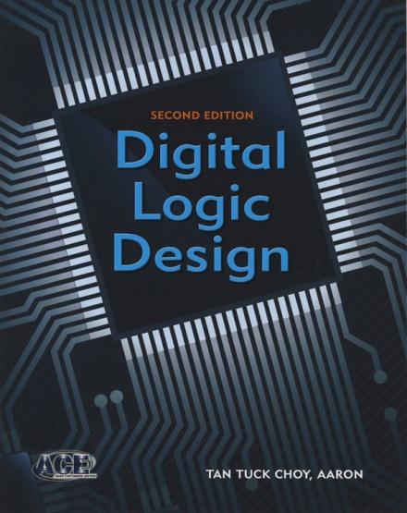
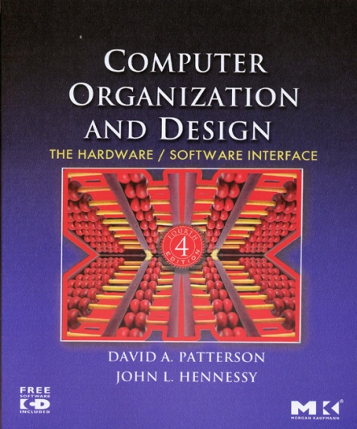
5. Textbooks
Digital Logic Design (DLD) 2nd edition by Aaron Tan McGraw-Hill
Book + ebook bundle (include errata sheet)
Please refer to module website “Errata” page for errors in the book.
Computer Organization and Design (COD), 4th edition by David A. Patterson and John L. Hennessy, 4th ed, Elsevier

Slide 11
6. Admin Matters (1/2)
Lectures are webcast (available on LumiNUS)
All course materials (lecture slides, tutorial questions, lab questions, etc.) will be uploaded on LumiNUS and the CS2100 website week by week
Tutorials and labs start in week 3 (28th Jan 2019)
Mid-term test
Tentative: 13 March 2019, Wednesday, 6 – 8pm
Waiting for RO’s confirmation on my booking request
Please check LumiNUS announcements for updates
Please post your queries on LumiNUS forums
Everybody can help answer and everybody can read the answers
Email me at tantc @ comp.nus.edu.sg only for personal matters

Slide 12
6. Admin Matters (2/2)
Online tutorial/lab registration – through CORS.
Lab group and tutorial group are independent.
Appeal through CORS, please do NOT email me!
Priority will be given to those without a group, instead of those who already have a group but wish to change.
Do not worry if your lab/tutorial is back to back with the lecture. I will be punctual in starting my lesson and CS2100 lectures/tutorials/labs should end 15 minutes before the hour.
After you get your assigned group, please stick with it.
If you need to attend another group for just one week, please send an email to me (at least a few days in advance) with your reason or attendance will not be taken by the tutor/labTA.

Slide 13
End of File

